Slide 1
Secure Dead Man’s Switch using Secret Sharing

Slide 2
Description:
A Secure Dead Man’s Switch ensures that sensitive information (like a key or message) is released only when certain conditions are met (e.g., the user doesn’t respond within a set time). This project uses Shamir’s Secret Sharing to securely split a secret into multiple parts (shares), ensuring that only a required threshold of shares can reconstruct the original secret.

Slide 3
Tech stack
HTML → webpage structure CSS → styling and consistency JavaScript → logic for Shamir’s Secret Sharing (generate & reconstruct secret) Design → follows Schneiderman’s Eight Golden Rules for usability Concept → splits a secret into parts; only threshold shares can recover it Platform → fully client-side, no server needed

Slide 4
Implementation of Golden Rules
1. Strive for Consistency
Applied in:
Consistent color palette, button style, and input design across all sections.
Uniform layout, grid, and typography for both Share Generation and Reconstruction pages.
Fonts, spacing, and padding are standardized throughout.
2. Enable Frequent Users to Use Shortcuts
Applied in:
Keyboard shortcuts (e.g., pressing Enter to submit forms).
Users can quickly regenerate or reconstruct shares after learning the workflow.
3. Offer Informative Feedback
Applied in:
Toast notifications or inline messages after generating or reconstructing shares.
Validation errors shown in red for issues like invalid inputs or missing data

Slide 5
4. Design Dialogs to Yield Closure
Applied in:
Each major action (e.g., share generation) ends with a confirmation message.
Success and Error dialogs clearly close the loop for each task.
5. Offer Simple Error Handling
Applied in:
Input validation ensures only valid primes and positive numbers are accepted.
Error messages clearly describe the issue and how to fix it no silent failures.
6. Permit Easy Reversal of Actions
Applied in:
“Clear All” and “Reset” buttons to undo or restart easily.
Users can clear temporary selections before reconstructing shares.

Slide 6
7. Support Internal Locus of Control
Applied in:
Users initiate all actions (generate / reconstruct shares).
No automatic actions — gives users full control and confidence in the process.
8. Reduce Short-Term Memory Load
Applied in:
Clear labels (“Secret Key”, “Threshold”, “Prime Number”) reduce memory dependence.
Generated shares remain visible for easy reconstruction.
Step-by-step flow ensures focus on one task at a time.

Slide 7

implementation

Slide 8
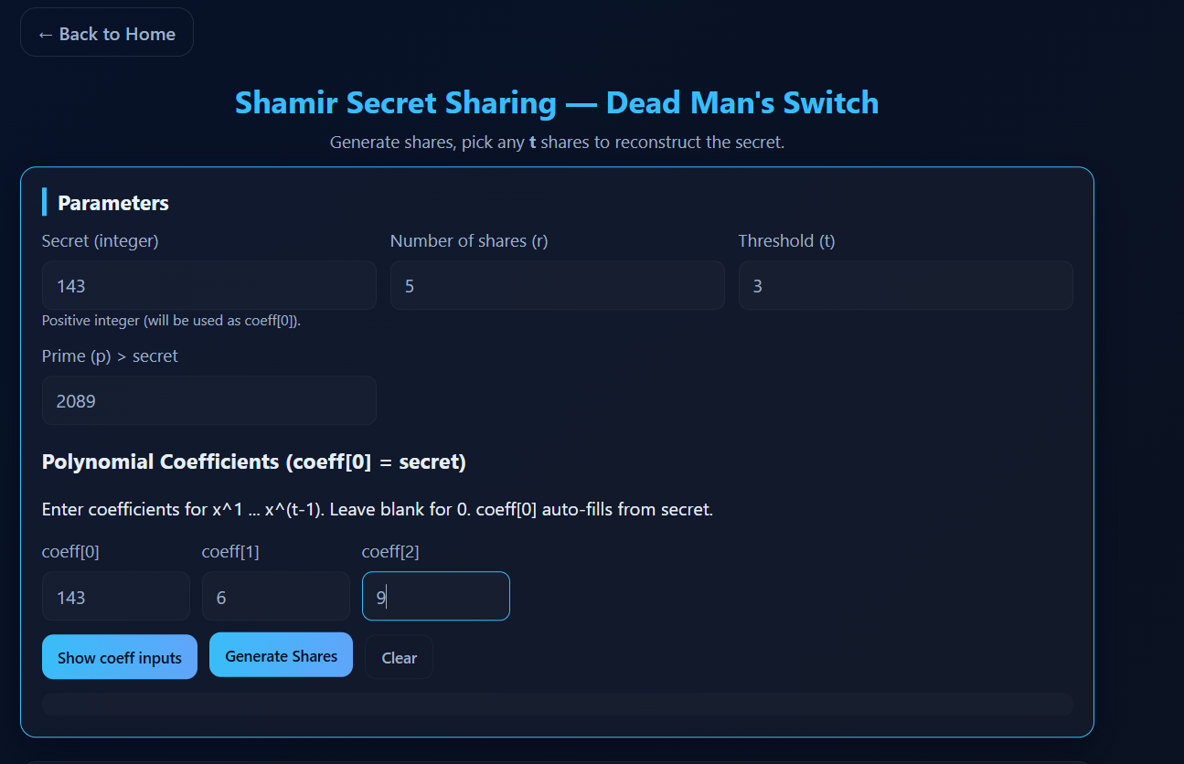

Slide 9
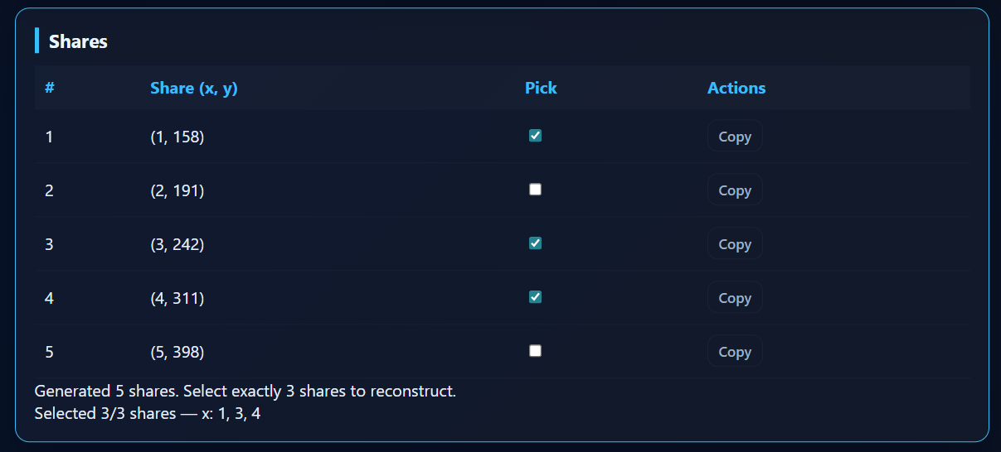

Slide 10
